Slide 1
Home Monitoring System
ECE 612 – Real Time Embedded Systems
Gowtham Tummala – G01123244

Slide 2
Objective
Collect the data of the house.
Send it through email.

Slide 3
Components
RaspberryPi B+ - 1
PIR Sensor - 1
Servo Motor - 1
DHT11 Sensor - 3
LCD 16x2 - 1
LED - 1
EDUP 802.11g - 1

Slide 4
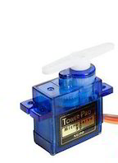

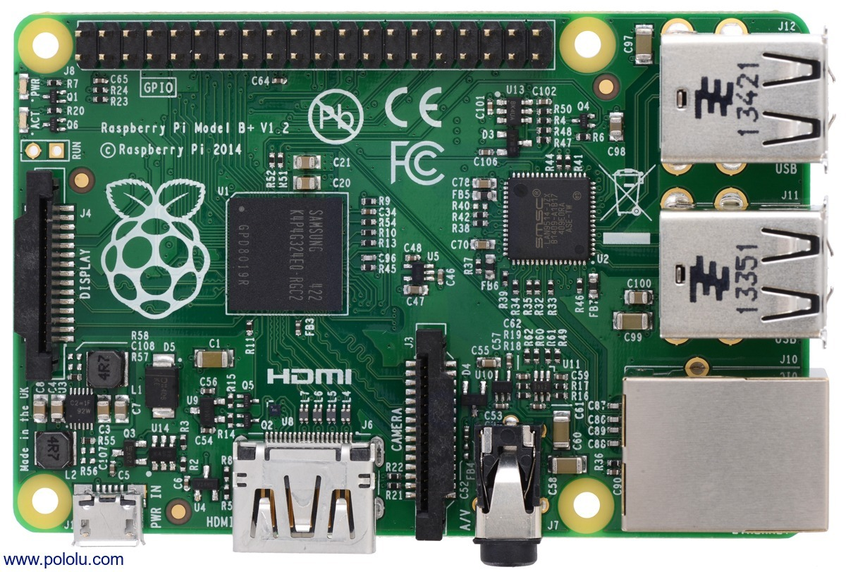
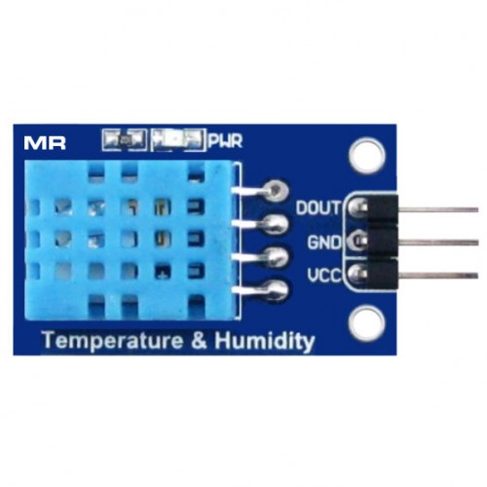
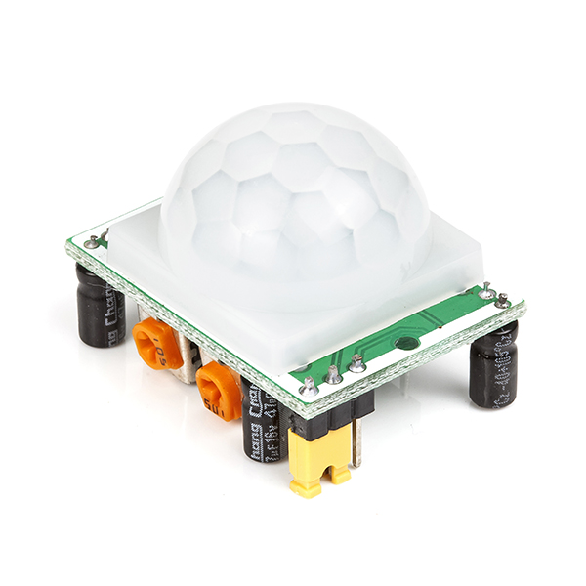

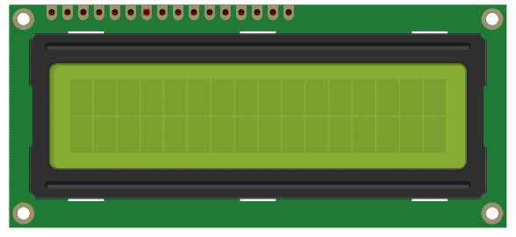
Design
Living Room
Room 1
Room 2

Slide 5
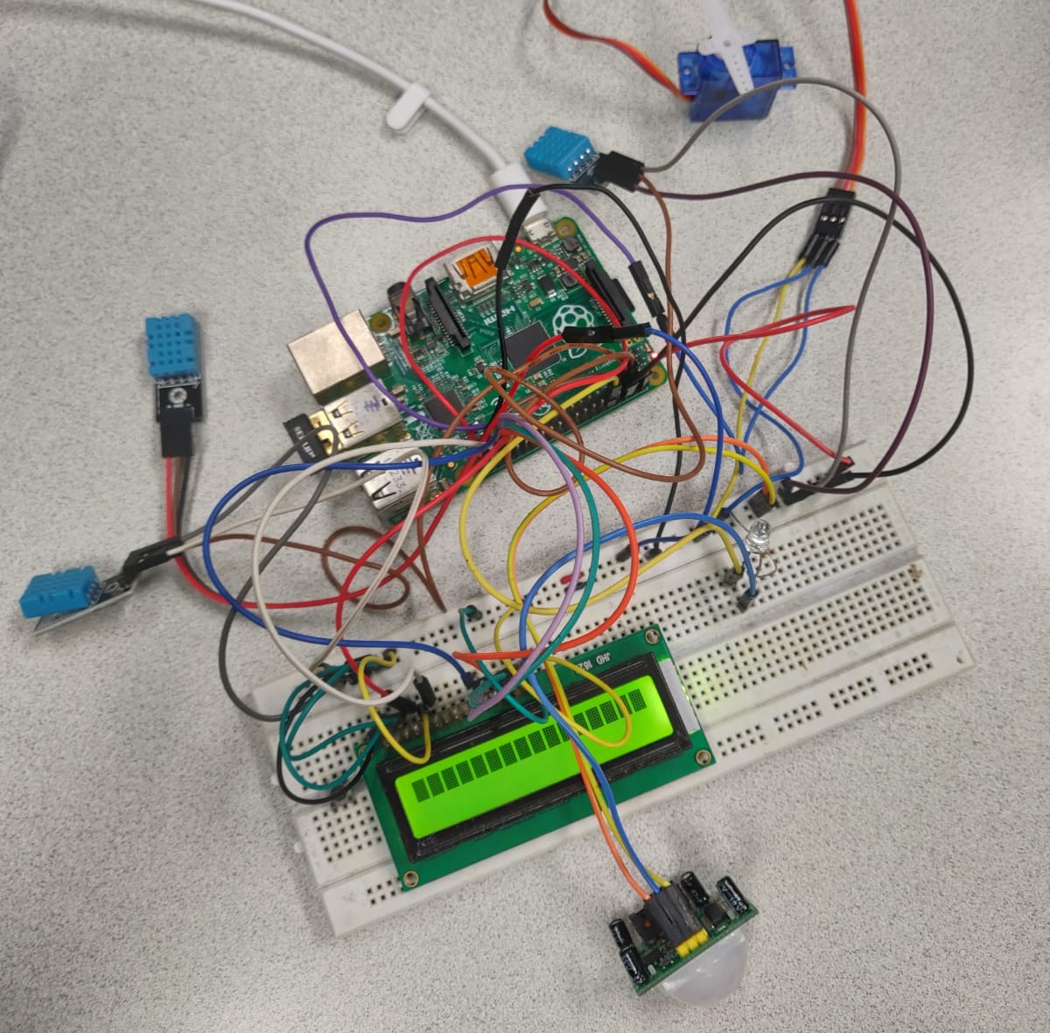
Real Time Setup

Slide 6
Working
Raspberry Pi collects data from 3 humidity and temperature sensors namely Living Room, Room 1 and Room 2 Sensors.
There is PIR sensor in Living Room, when it detects any motion it turns on Light in the living room.
There is one servo motor in room 1 if the humidity in the room is greater than 80% servo motor opens window.
There is LCD screen that shows all the data that generated inside the house.

Slide 7
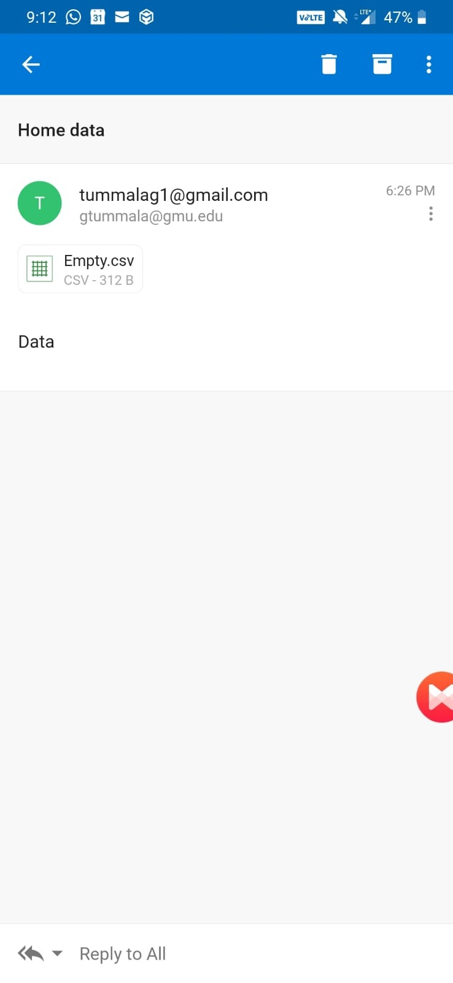
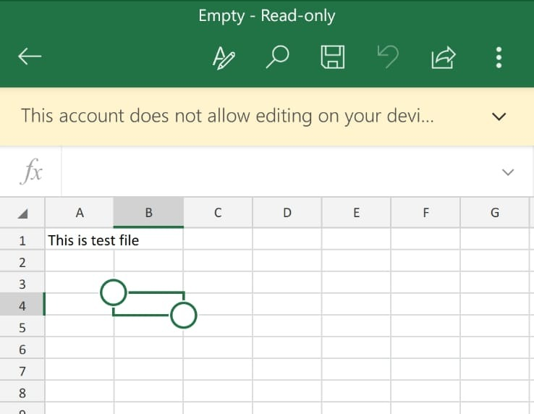
Results: Test file

Slide 8
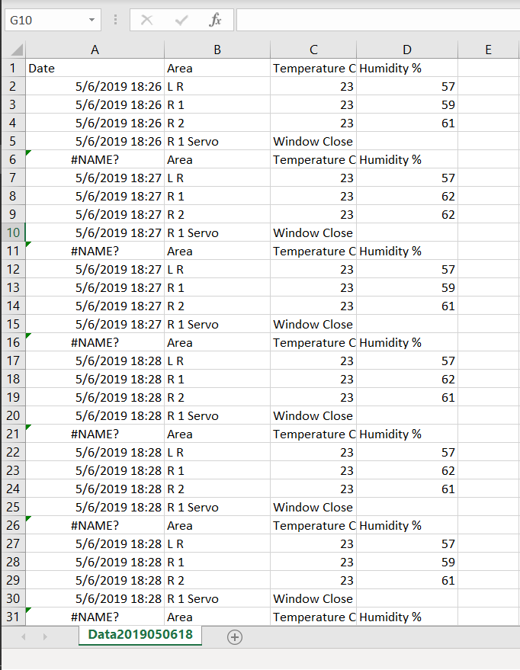

Results: Data File

Slide 9
Thank you

